Slide 1
Runway Incursion Warning System (RWIS)
Wayne County Airport Authority – DTW
September 2023

Slide 2
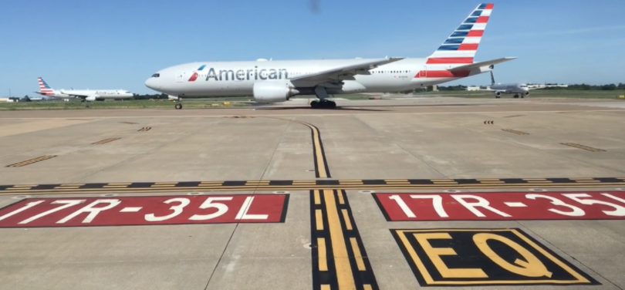
WHAT IS A RUNWAY INCURSION WARNING SYSTEM (RIWS)?
RIWS serves as an added SafetyNet to a vehicle operator in the AOA. It works by providing a driver with a visual and audible alert as they approach hold short areas or the RSA.
It is intended to serve as a reminder to the driver of their proximity to the RSA and to allow them to stop or change direction if they were not intending to enter the RSA or were not cleared to enter the RSA
RIWS is intended to add to the situational awareness of the driver to prevent runway incursions and promote your safety.
© 2020 Leonardo/Selex ES Inc.
2

Slide 3
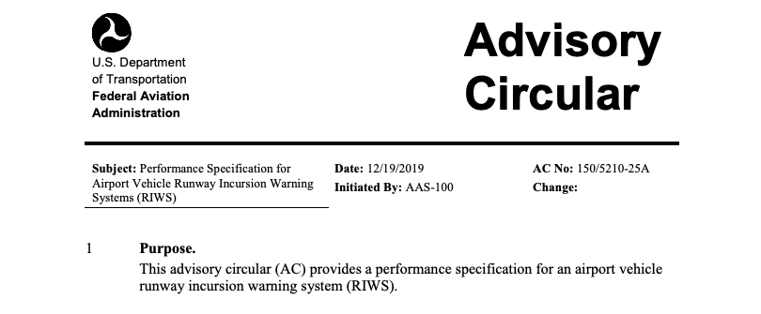
“The RIWS should be used as a situational awareness tool. The use of RIWS does not relieve vehicle operators of their responsibilities relevant to airport familiarity, situational awareness, driver training, and following air traffic controllers’ instructions when driving on the AOA.”
FAA AC 150/5210-25A - Performance Specification for Airport Vehicle Runway Incursion Warning System https://www.faa.gov/documentLibrary/media/Advisory_Circular/150-5210-25A.pdf
IT IS THE RESPONSIBILITY OF THE DRIVER TO FOLLOW ALL INSTRUCTIONS FROM ATC WHILE IN THE AOA AND TO REMAIN CLEAR OF RUNWAY SAFETY AREAS UNLESS AUTHORIZED BY ATC.
© 2020 Leonardo/Selex ES Inc.
3

Slide 4
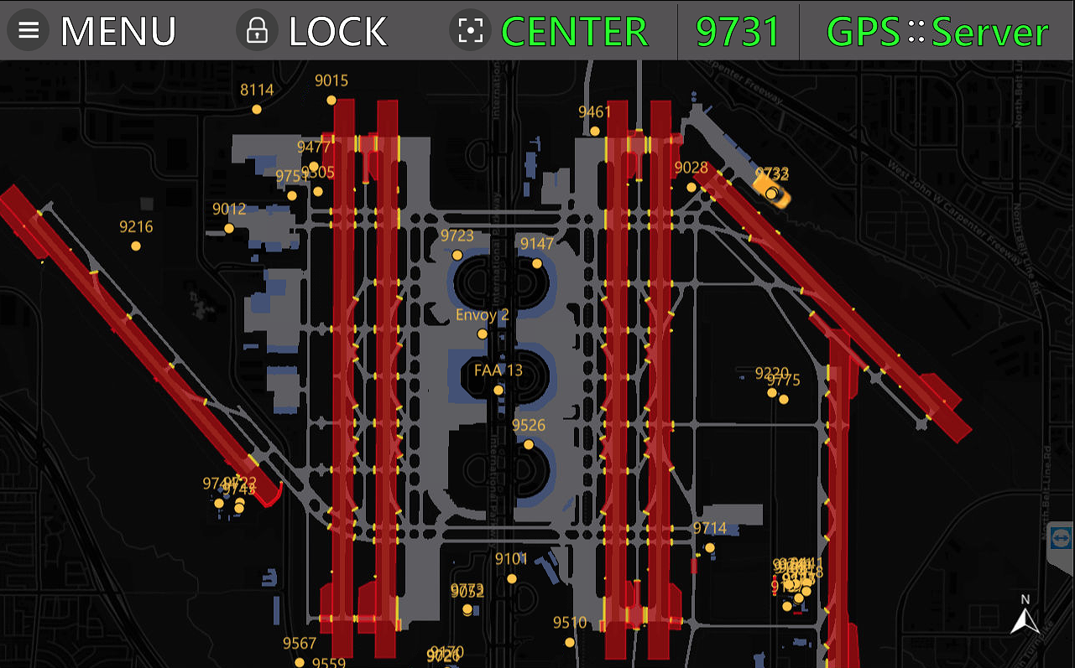
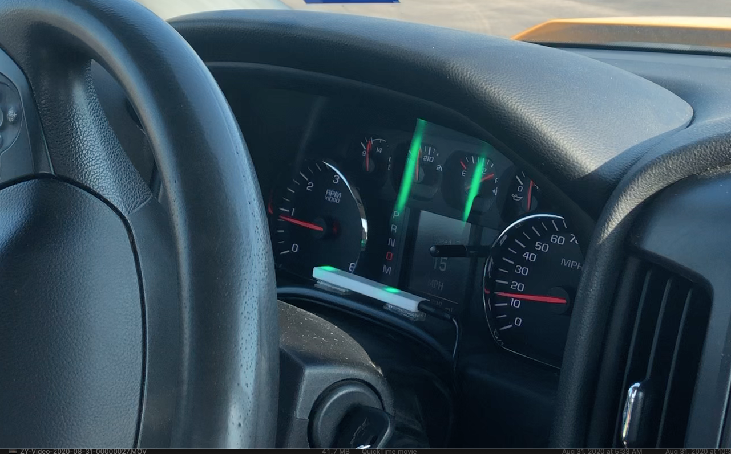
DTW HAS TWO TYPES OF RIWS HARDWARE
DTW chose to install two (2) types of hardware two support RIWS. Both of these offer the same critical safety alert logic and vehicle tracking capabilities. The only difference between one and the other is that the “Portable” RIWS system does not have a display to show a moving map.
“Portable” RIWS Lite System
”Hard-wired” with Moving Map Display
© 2020 Leonardo/Selex ES Inc.
4

Slide 5
THREE KEY PARTS OF AN RIWS SYSTEM
RIWS technology relies on three key components to provide the driver with alerts as they approach or enter runway safety areas.
These key components are:
GPS - Used to locate the vehicle and provide direction of travel and speed
ALERT AREAS & MAP - Alert areas are used to identify the location where the alerts are triggered and the moving map provides situational awareness for the driver in the event of becoming disoriented.
ALERTING MECHANISM - Visual and audible alerts are key to the system to provide the drivers with the alert prior to the vehicle entering the alert area.
© 2020 Leonardo/Selex ES Inc.
5

Slide 6
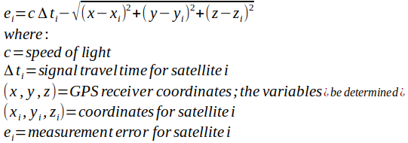
GPS TECHNOLOGY AND HOW IT WORKS
GPS Technology is “rocket science” !!
This formula is computed 5-10 times per second, per satellite in view of the GPS, which averages 11-15 satellites.
Non-military GPS systems accuracy ranges from 5.1’- 9.9’ (1.7-2.7 meters) 95% of the time. This varies based on the number of satellites in view of the GPS receiver and the location of the satellites. Only military grade GPS receivers offer “sub-meter” accuracy 99.9% of the time.
© 2020 Leonardo/Selex ES Inc.
6

Slide 7
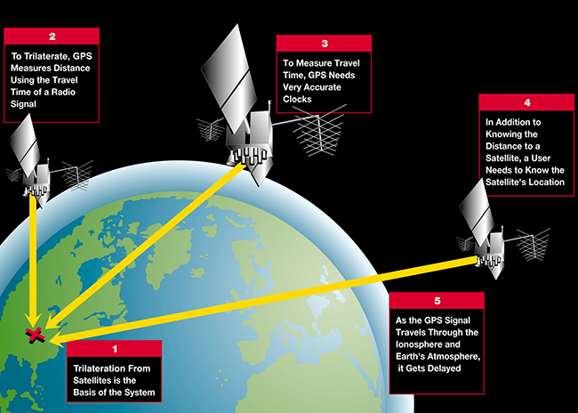
GPS TECHNOLOGY AND HOW IT WORKS
© 2020 Leonardo/Selex ES Inc.
7

Slide 8
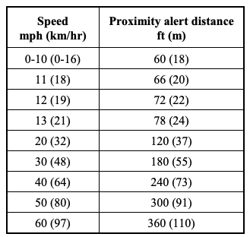
HOW DOES RIWS WORK
RIWS works by using the location, speed and direction of travel of the vehicle, from the GPS (at a rate of 5-10 times per second), and creating a safety area ahead of the vehicle that is based on the FAA RIWS AC.
This safety area is then used to determine if the vehicle is approaching a hazard area from the airport map.
45MPH
30MPH
20 MPH
120 feet
40 MPH
240 feet
© 2020 Leonardo/Selex ES Inc.
8

Slide 9
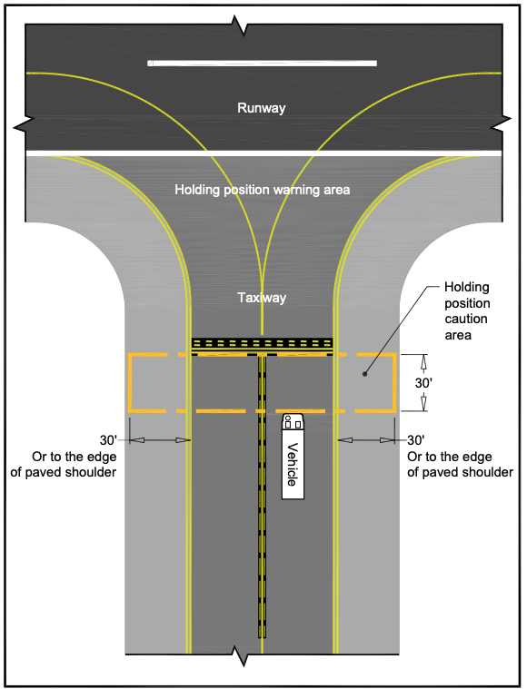
RUNWAY SAFETY AREAS (AKA ALERT AREAS)
Around each of the runways there are areas that are setup to trigger the alert tone and visual for each vehicle. The size and location of each of these areas is defined in the FAA AC. At a minimum RIWS system must have the following;
Hold Short Lines - 30’ from the line away from the RSA
Runway Safety Area - an area that encompasses the full RSA. At DTW this is 250’ from the center of the runway to each side and 1000’ past the end of the runway.
ILS Critical Areas - areas that encompass the full critical area space when the airport is operating in reduced visibility conditions.
*** FAA AC allows each airport to adjust their own alert areas as needed. DTW has undergone 6 different version of the Alert Area Map
© 2020 Leonardo/Selex ES Inc.
9

Slide 10
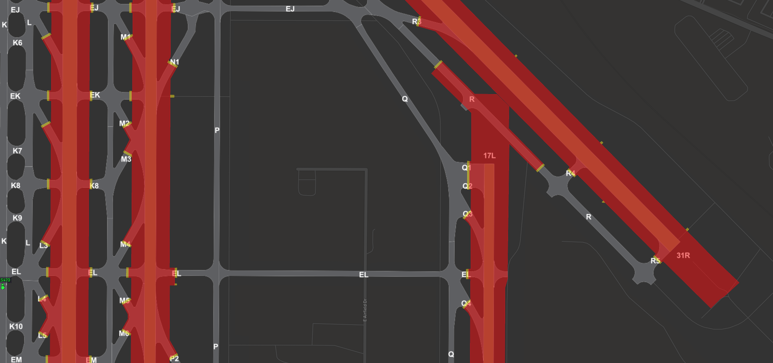
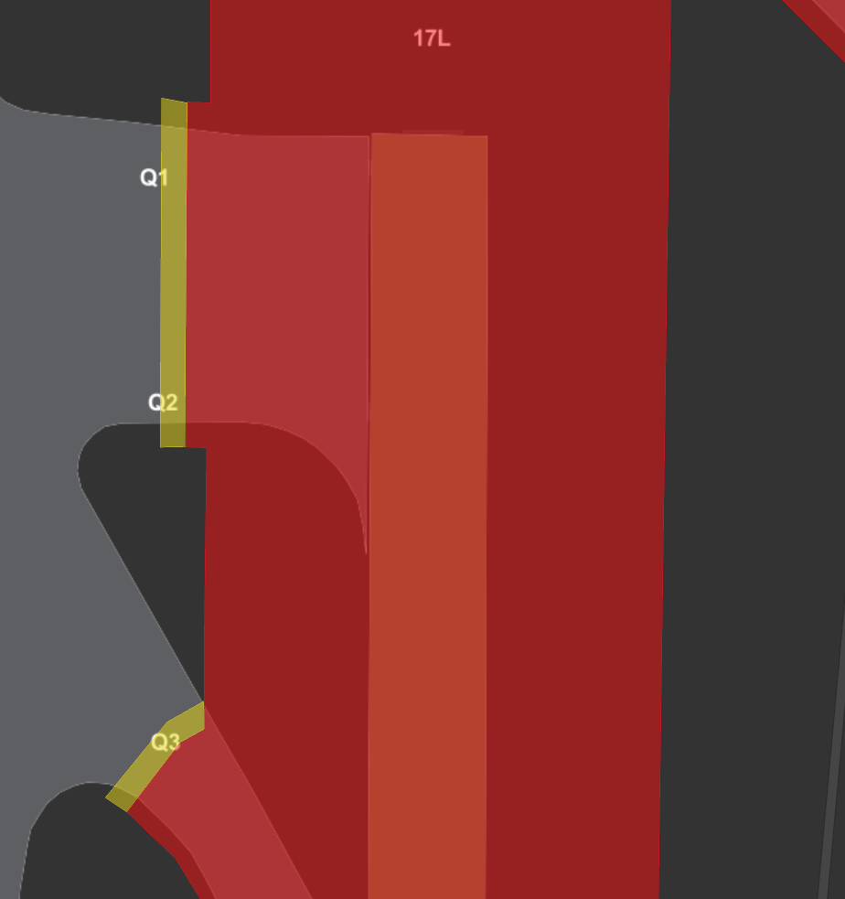
EXAMPLE OF ALERT AREA
HOLD SHORT 30’ ZONE RSA AREA
© 2020 Leonardo/Selex ES Inc.
10

Slide 11
GPS AND ALERT AREAS WORKING TOGETHER
45MPH
30MPH
© 2020 Leonardo/Selex ES Inc.
11

Slide 12
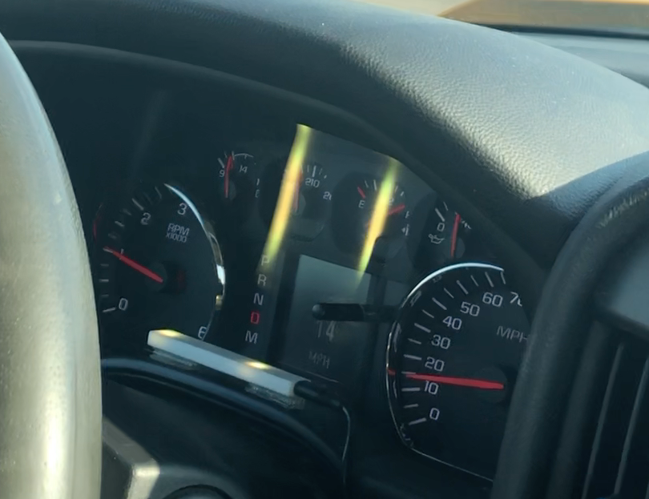
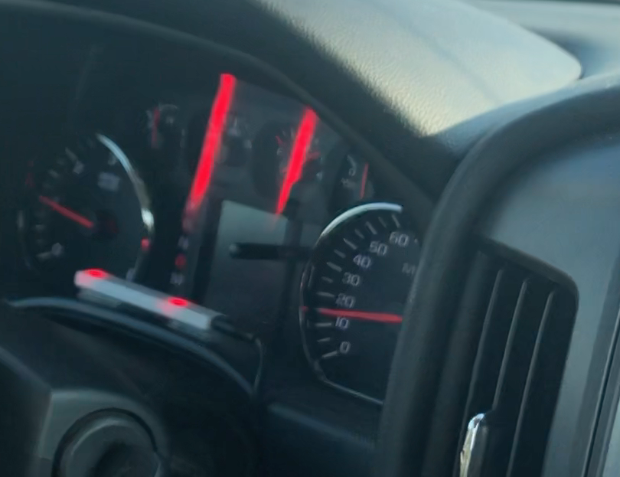
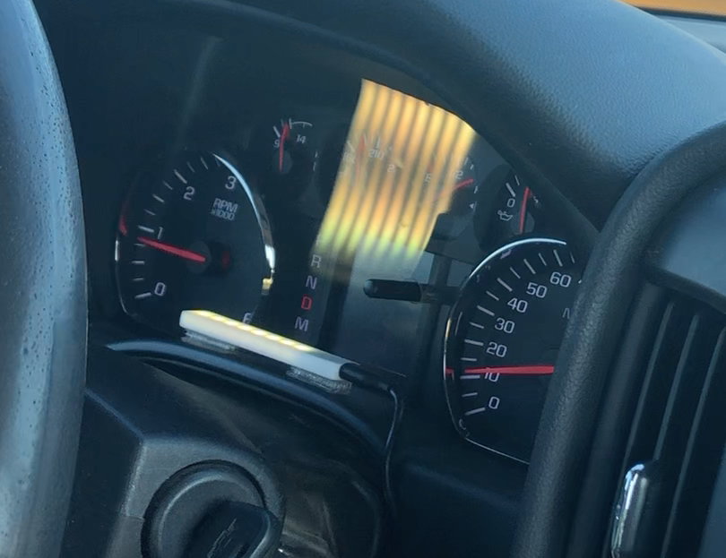
RIWS ALERTS - WHAT TO EXPECT
The RIWS alerts a driver through both visual and audible alerts.
Visual alerts take two forms:
LED Annunciator
Display on Moving Map
Audible alerts are the same with both systems
CAUTION APPROACHING RSA 17C/35C
CAUTION APPROACHING HOLD SHORT 17L/35R AT Q2
© 2020 Leonardo/Selex ES Inc.
12

Slide 13
LED LIGHTS - WHAT DO THEY TELL ME
NETWORK
ILS
GPS
CABLE
NETWORK
GPS
No Lights, unit has no power, or LED disconnected
NETWORK
GPS
45MPH
GPS OK and Accurate <3m / Network Connected
These light patterns indicate system is working properly
NETWORK
GPS
45MPH
GPS NOT OK and Accurate >3m / Network Connected
NETWORK
GPS
45MPH
30MPH
GPS NOT OK and Accurate >3m / Network NOT Connected
NETWORK
ILS
GPS
45MPH
GPS OK and Accurate <3m / ILS Area Active Network Connected
45MPH
Vehicle Approaching Hold Short 30’ Area
These light patterns indicate RSA warnings
45MPH
30MPH
Vehicle Approaching RSA
45MPH
Vehicle Inside Hold Short 30’ Area
45MPH
Vehicle Inside RSA
© 2020 Leonardo/Selex ES Inc.
13

Slide 14
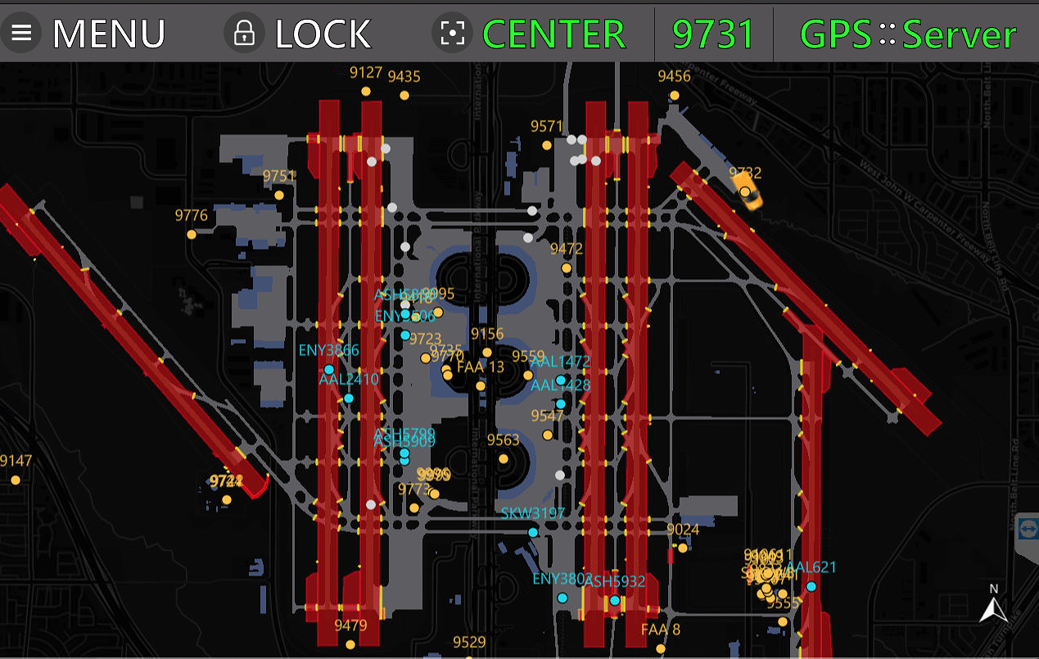
MAP DISPLAY OVERVIEW - WHAT? HOW? WHERE?
© 2020 Leonardo/Selex ES Inc.
14

Slide 15
If you are experiencing a problem with an RIWS device, report to your foremen/manager and Email the following details to matt.cairns@wcaa.us & david.bogle@wcaa.us:
Your name and contact details
Asset ID of the device
Detailed description of the problem
Date and time of the problem
Approximate location in the AOA where the problem took place
Screen pictures at the time of the issue (if possible)
Thank You

