Slide 1
Runway Incursion Warning System (RWIS)
Installation of Portable System
April 2024

Slide 2
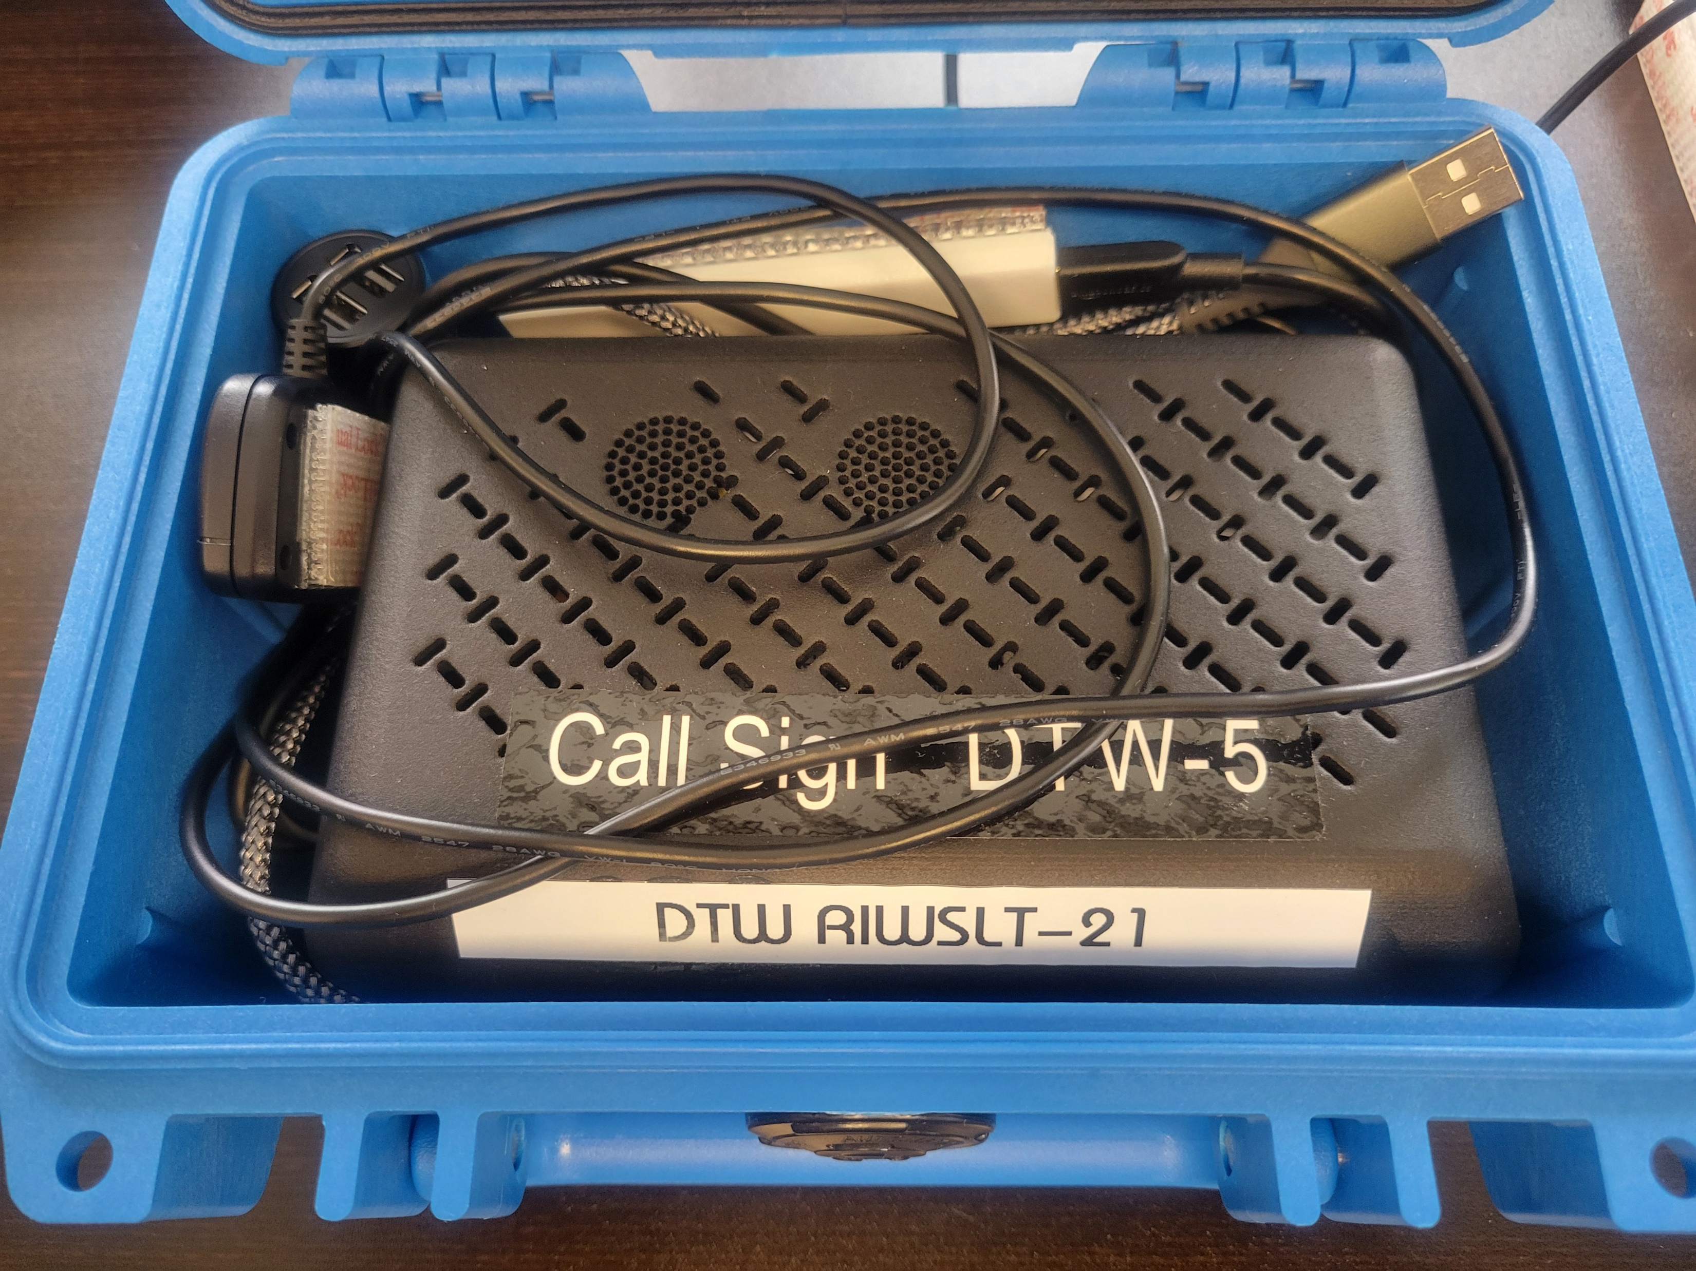
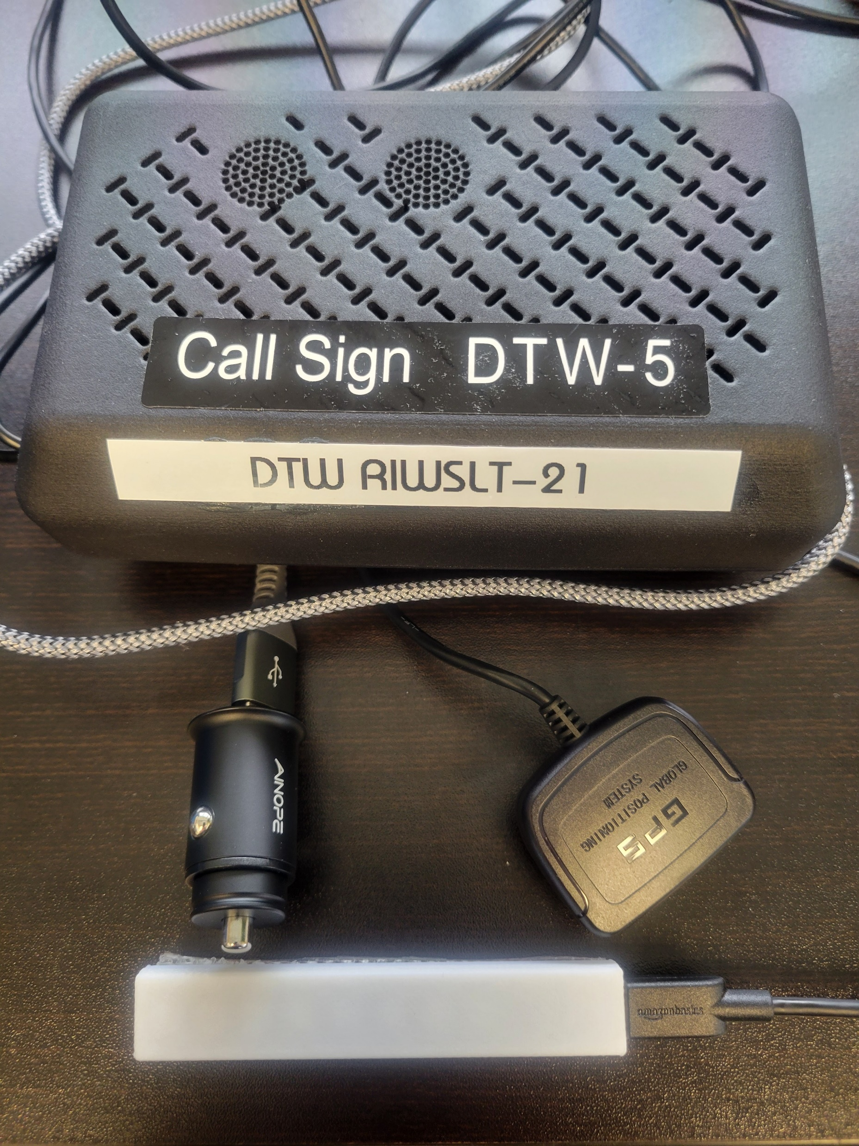
RIWS PORTABLE HARDWARE
Portable units can be checked out from Inventory. Callsign sticker is on the outside of the box and on the unit itself. Four components:
USB Charger (with adapter)
GPS receiver
Light Bar
Speaker box
© 2020 Leonardo/Selex ES Inc.
2

Slide 3
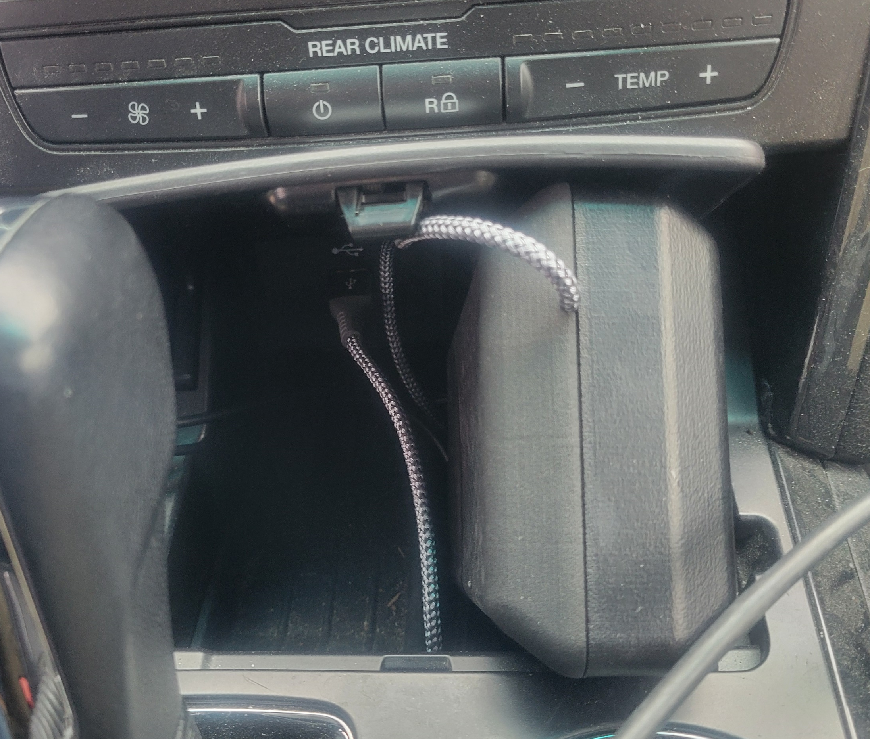
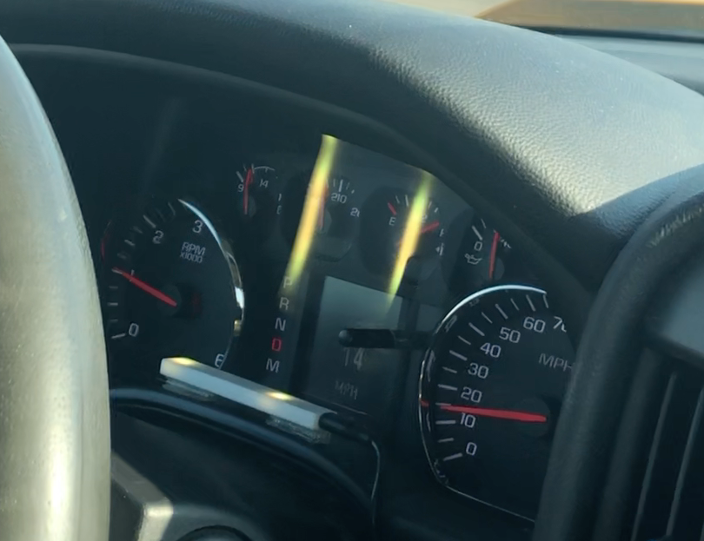
INSTALLATION OF PORTABLE SYSTEM
Plug in USB power to either a USB power outlet or provided lighter adapter:
After a few seconds, you will hear an audible “chirp” and see the LED lights
Speaker box should be stored out of direct sunlight
Place GPS receiver on the dashboard with provided Velcro
Place light bar on the instrument panel (or anywhere within view of the driver) with provided Velcro
© 2020 Leonardo/Selex ES Inc.
3

Slide 4
LED LIGHTS - WHAT DO THEY TELL ME
NETWORK
ILS
GPS
CABLE
NETWORK
GPS
No Lights, unit has no power, or LED disconnected
NETWORK
GPS
45MPH
GPS OK and Accurate <3m / Network Connected
These light patterns indicate system is working properly
NETWORK
GPS
45MPH
GPS NOT OK and Accurate >3m / Network Connected
NETWORK
GPS
45MPH
30MPH
GPS NOT OK and Accurate >3m / Network NOT Connected
NETWORK
ILS
GPS
45MPH
GPS OK and Accurate <3m / ILS Area Active Network Connected
45MPH
Vehicle Approaching Hold Short 30’ Area
These light patterns indicate RSA warnings
45MPH
30MPH
Vehicle Approaching RSA
45MPH
Vehicle Inside Hold Short 30’ Area
45MPH
Vehicle Inside RSA
© 2020 Leonardo/Selex ES Inc.
4

Slide 5
If you are experiencing a problem with an RIWS device, report to your foremen/manager and Email the following details to matt.cairns@wcaa.us & david.bogle@wcaa.us:
Your name and contact details
Asset ID of the device
Detailed description of the problem
Date and time of the problem
Approximate location in the AOA where the problem took place
Screen pictures at the time of the issue (if possible)
Thank You

